Slide 1


Hospital management system
Made by : Yash pawar ,
Ujwal sahu ,
Ritesh yadav

Slide 2
OBJECTIVE •Designed to automate the working of the entire hospital. •In short the project aims computerization as a patient care tool rather than more accounting and inventory mechanisms. • The patient information and case study are given priority. The system is developed using python , SQL lite , tkinter for gui .

Slide 3
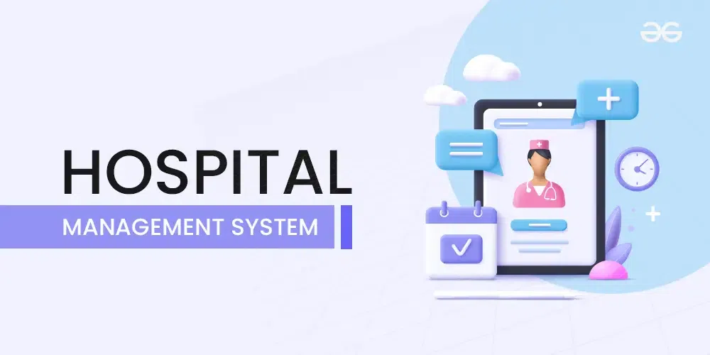
What is a Hospital Management System (HMS)?
A Hospital Management System is a digital platform designed to manage healthcare data and processes like patient records, appointments, billing, and medical histories.
An efficient HMS optimizes hospital workflows, reduces paperwork, and ensures better patient care.

Slide 4
Functions of the Hospital
• To provide care for the sick and injured.
• Training of physicians, nurses and other personnel
• Prevention of disease and promotion of health.
• Advancement of research in scientific medicine.
Innovations in hospital
• Auto check-in and checkout.
• Specialty hospitals.
• Hospital administration.
• Medical records management.
• Oxygen under pressure treatment.
• Waste management.

Slide 5
Technologies Used :
Programming Language: Python
Libraries/Frameworks:
Tkinter: For the GUI.
PIL (Pillow): For handling images in the interface.
SQLite: For database management.
Tools Used:
Python IDE (like PyCharm, VS Code)
SQLite Database Browser

Slide 6
Project Motivation :
Our aim was to create a simple yet effective management solution that can be easily implemented in small to medium-sized clinics.
By digitizing core hospital functions, we make operations more efficient and improve patient experience.

Slide 7
HOME PAGE
SIGNUP PAGE
LOGIN PAGE
LOGIN SUCCESFULLY
SINGED UP SUCCESSFULLY
FAILURE MESSAGE
USER : - DOCTOR
USER : - PATIENT
DOCTOR DASHBOARD
PATIENT DASHBOARD

Slide 8
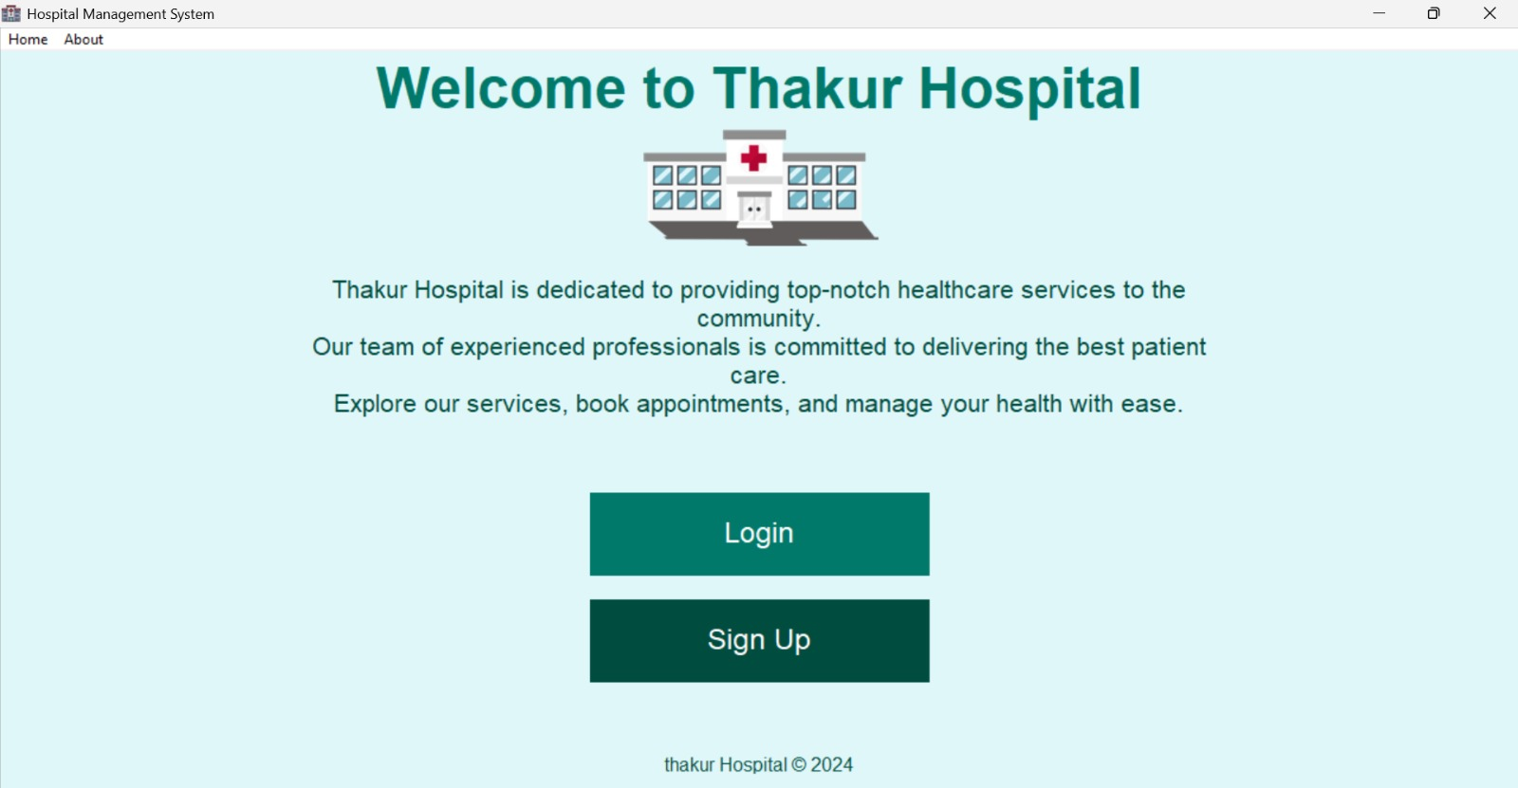
HOME PAGE

Slide 9
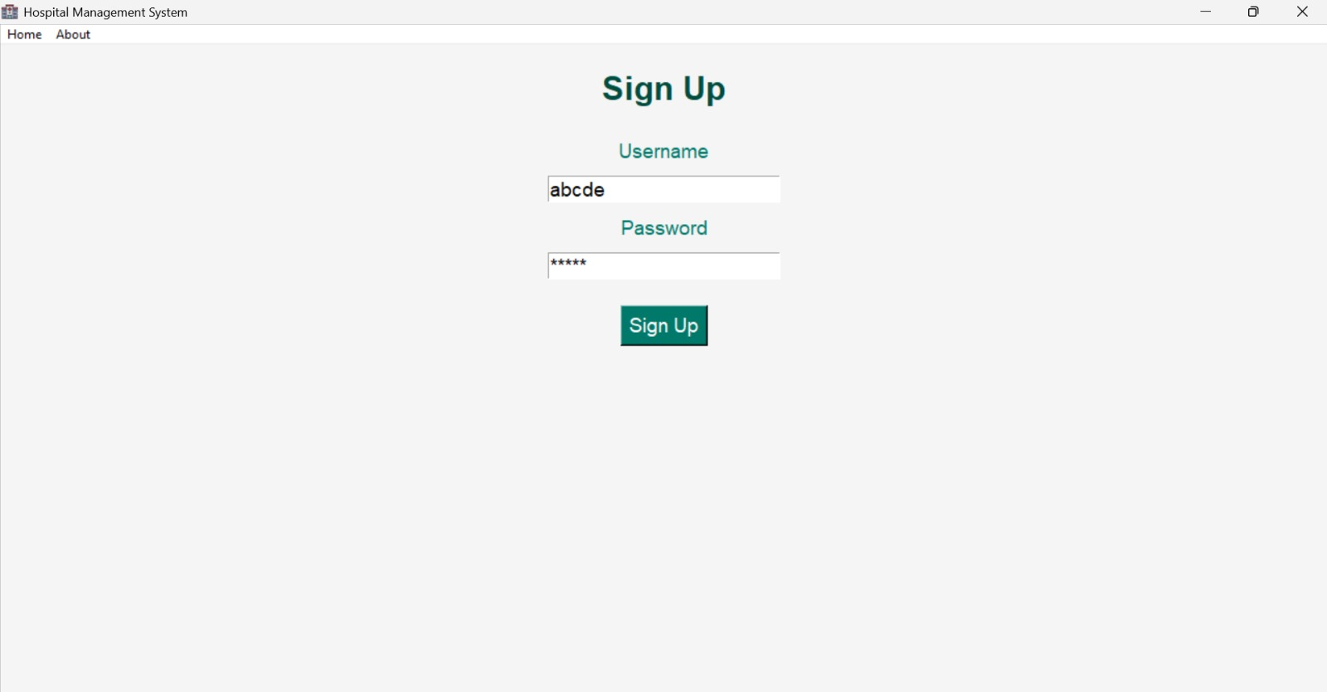
SIGN UP PAGE FOR PATIENTS
This page generally stores the data of the patients by using the sign up page,
management will get the better access to data.

Slide 10
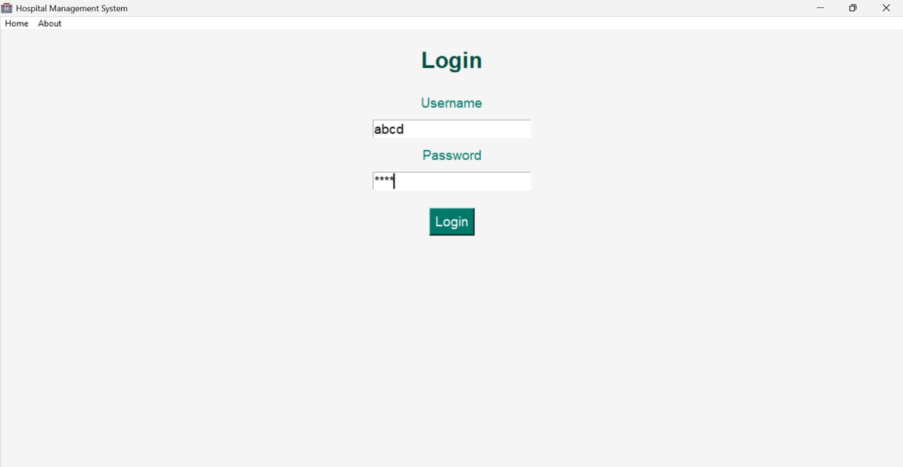
Login page for patients
Secure Patient Portal: Clearly label the login page as a secure patient portal.
Password Reset and Recovery: Provide options for resetting or recovering login credentials.
Clear Instructions and Labels: Use simple language and clear labels for login fields.

Slide 11
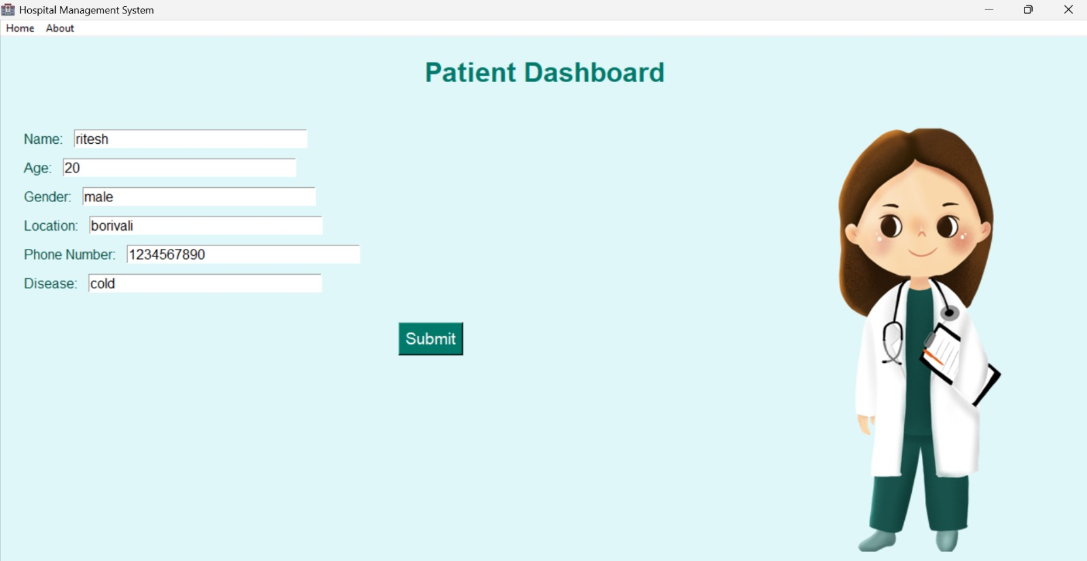
PATIENT DASHBOARD
Patient registration (in patient/out patient)

Slide 12
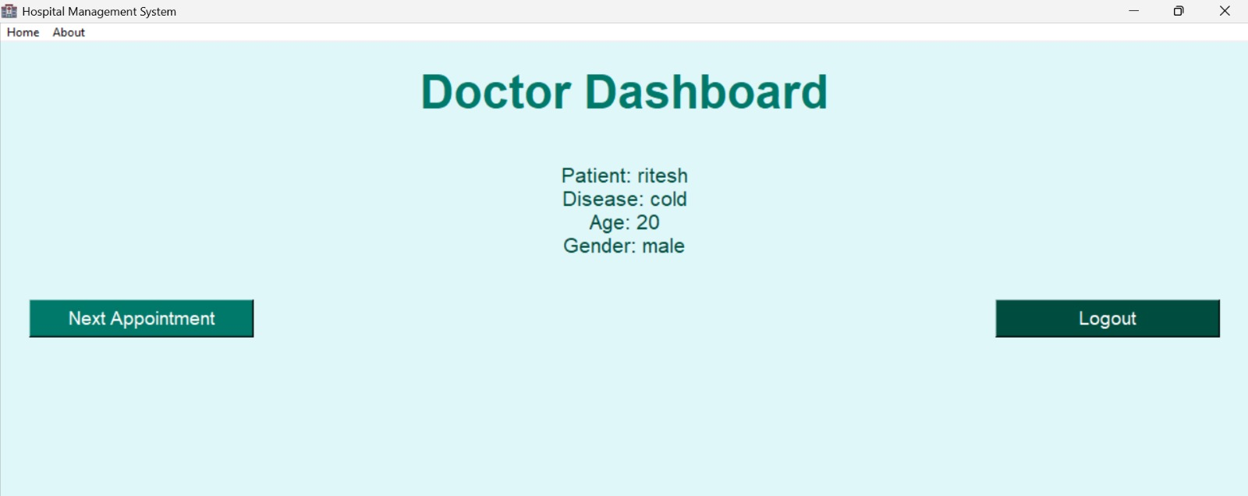
User-Friendly Interface: Intuitive design for easy navigation.
2. Patient List/Registry: Display a list of assigned patients with key information.
3. Schedule and Appointments: View and manage upcoming appointments and schedules.
4. Patient Medical Records: Access and update patient medical histories, diagnoses, and treatments.

Slide 13
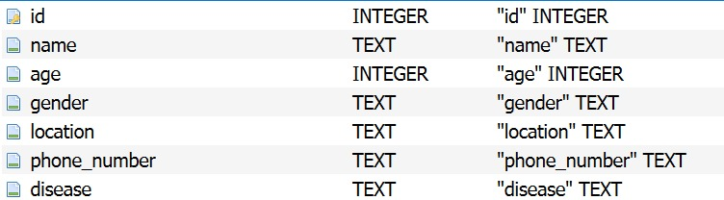

APPOINTMENT TABLE
USER TABLE

Slide 14
Conclusion:
Our system simplifies hospital management, reduces manual errors, and ensures smoother operations.
This is especially valuable in small clinics where resources are limited."
Future Scope :
Adding billing and prescription management features.Integrating more robust security
measures.
Expanding to include more specialized healthcare modules.

